Slide 1


Machine Learning LAB
PCA and Random Forest

Slide 2
Principal Components Analysis
1 - Imports
2.1 - Loading the data
2.2 - Applying PCA
2.3 - Visualizing the Principal Components
2.4 - Interpreting the Principal Components
2.5 - Explained Variance Ratio
2.6 - Choosing the Number of Components
3 - PCA for Digits Visualization

Slide 3
IMPORTS
import numpy as np
import pandas as pd
import seaborn as sns
import matplotlib.pyplot as plt
from sklearn.datasets import load_wine, load_digits
from sklearn.preprocessing import StandardScaler
from sklearn.decomposition import PCA

Slide 4
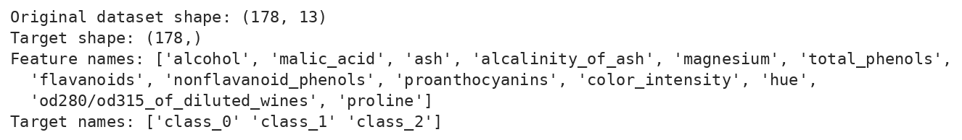
LOADING THE DATA
wine = load_wine()
X = wine.data
y = wine.target
feat_names = wine.feature_names
target_names = wine.target_names
print("Original dataset shape:", X.shape)
print("Target shape:", y.shape)
print("Feature names:", feat_names)
print("Target names:", target_names)

Slide 5

APPLYING PCA
# Step 1: Standardize the data
scaler = StandardScaler()
X_scaled = scaler.fit_transform(X)
# Step 2: Reduce the data to two principal components
pca = PCA(n_components=2)
X_reduced = pca.fit_transform(X_scaled)
print("Original dataset shape:", X.shape)
print("Reduced dataset shape:", X_reduced.shape)

Slide 6
VISUALIZING COMPONENTS
wine_colors = ['orangered', 'darkred', 'crimson']
plt.figure(figsize=(10, 6))
for class_num, color, target_name in zip(
[0, 1, 2], wine_colors, target_names
):
plt.scatter(
X_reduced[y == class_num, 0],
X_reduced[y == class_num, 1],
color=color,
label=target_name,
alpha=0.7
)
plt.title('PCA of Wine Dataset')
plt.xlabel('First Principal Component')
plt.ylabel('Second Principal Component')
plt.legend()
plt.grid(alpha=0.2)
plt.show()

Slide 7
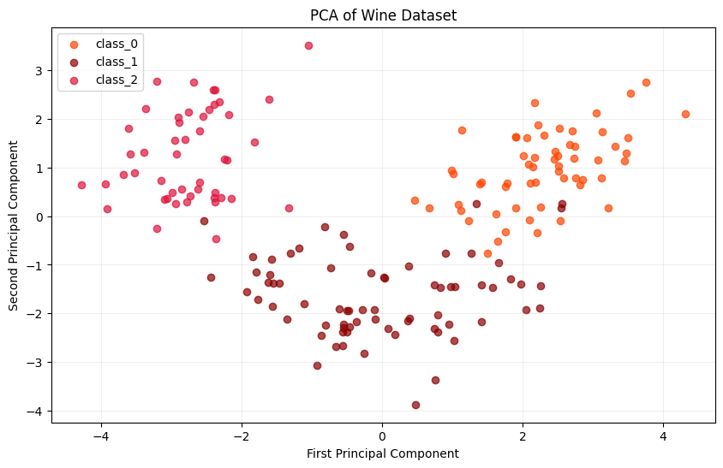
PCA OF WINE DATASET

Slide 8
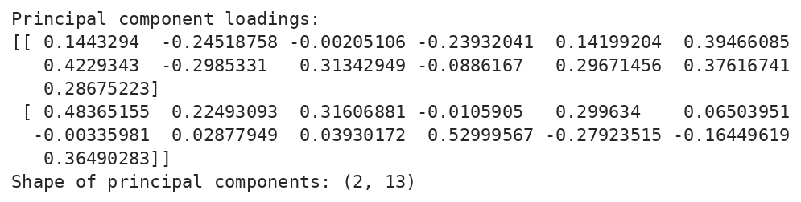
INTERPRETING COMPONENTS
print("Principal component loadings:")
print(pca.components_)
print("Shape of principal components:", pca.components_.shape)

Slide 9
COMPONENTS HEATMAP
plt.figure(figsize=(14, 5))
sns.heatmap(
pca.components_,
cmap='viridis',
xticklabels=feat_names,
yticklabels=['First Component', 'Second Component']
)
plt.title('PCA Component Loadings')
plt.xlabel('Original Features')
plt.ylabel('Principal Components')
plt.xticks(rotation=45, ha='right')
plt.tight_layout()
plt.show()

Slide 10
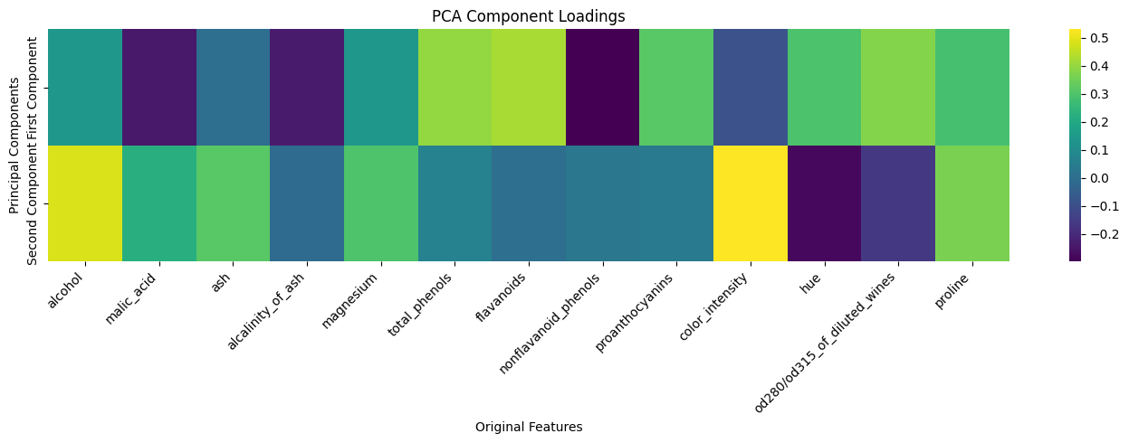
PCA COMPONENT LOADINGS

Slide 11
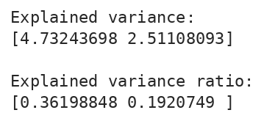
EXPLAINED VARIANCE RATIO
print("Explained variance:")
print(pca.explained_variance_)
print("\nExplained variance ratio:")
print(pca.explained_variance_ratio_)

Slide 12
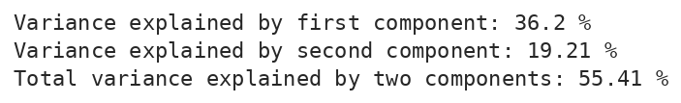
VARIANCE EXPLAINED
print("Variance explained by first component:",
round(pca.explained_variance_ratio_[0] * 100, 2), "%")
print("Variance explained by second component:",
round(pca.explained_variance_ratio_[1] * 100, 2), "%")
print("Total variance explained by two components:",
round(np.sum(pca.explained_variance_ratio_) * 100, 2), "%")
After scaling, no single feature dominates, so the variance is shared between the components. Two components keep 55.41% of the total. On the raw data, 'proline' has by far the largest scale and pushed the first component to about 99.8%.

Slide 13
CHOOSING COMPONENTS
# Apply PCA using all components
pca_2 = PCA()
pca_2.fit(X_scaled)
exp_var_ratio = pca_2.explained_variance_ratio_
cumsum = np.cumsum(exp_var_ratio)
plt.figure(figsize=(8, 5))
plt.plot(
range(1, len(cumsum) + 1),
cumsum,
marker='o'
)
plt.xlabel('Number of Components')
plt.ylabel('Cumulative Explained Variance')
plt.title('Cumulative Explained Variance')
plt.xticks(range(1, len(cumsum) + 1))
plt.grid()
plt.show()

Slide 14
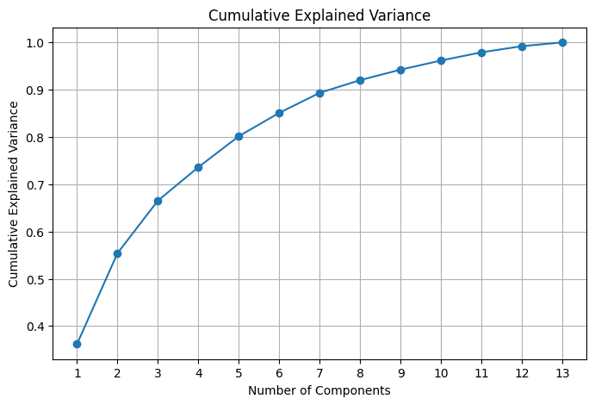
CUMULATIVE VARIANCE

Slide 15
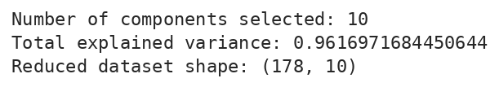
CHOOSING BY VARIANCE
# Keep enough components to explain at least 96% of variance
pca_3 = PCA(n_components=0.96)
X_reduced_96 = pca_3.fit_transform(X_scaled)
print("Number of components selected:", pca_3.n_components_)
print("Total explained variance:",
np.sum(pca_3.explained_variance_ratio_))
print("Reduced dataset shape:", X_reduced_96.shape)

Slide 16

PCA ON DIGITS DATA
digits = load_digits()
digits_data = digits.data
digits_target = digits.target
print("Original Digits dataset shape:", digits_data.shape)
# Reduce the digit images to two components
dig_pca = PCA(n_components=2)
digit_reduced = dig_pca.fit_transform(digits_data)
print("Reduced Digits dataset shape:", digit_reduced.shape)

Slide 17
VISUALIZING THE DIGITS
plt.figure(figsize=(10, 6))
scatter = plt.scatter(
digit_reduced[:, 0],
digit_reduced[:, 1],
c=digits_target,
cmap='jet',
edgecolors='none'
)
plt.xlabel('First Principal Component')
plt.ylabel('Second Principal Component')
plt.title('PCA Visualization of Digits Dataset')
plt.colorbar(scatter, label='Digit Class')
plt.grid(alpha=0.2)
plt.show()

Slide 18
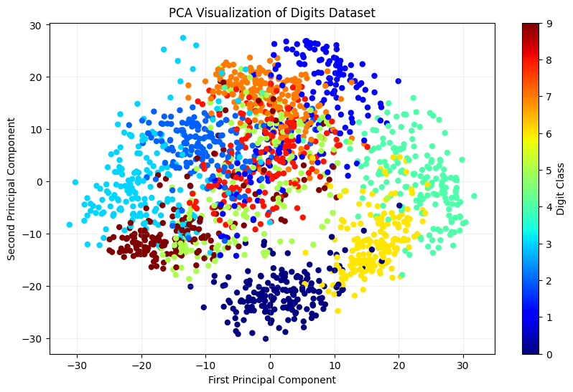
PCA OF DIGITS DATASET

Slide 19
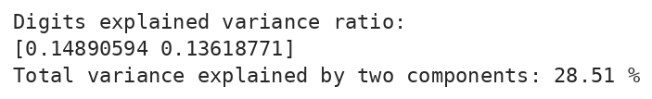
DIGITS EXPLAINED VARIANCE
print("Digits explained variance ratio:")
print(dig_pca.explained_variance_ratio_)
print("Total variance explained by two components:",
round(np.sum(dig_pca.explained_variance_ratio_) * 100, 2), "%")
Two components keep only 28.51% of the variance here, so the digit classes overlap a lot in the 2D plot.

Slide 20
Random Forests for Regression
1 - Imports
2 - Loading the data
3 - Data visualization
4 - Features and target
5 - Splitting the data
6 - Training an initial forest

Slide 21
IMPORTS
import numpy as np
import pandas as pd
import matplotlib.pyplot as plt
import seaborn as sns
from sklearn.model_selection import train_test_split, GridSearchCV
from sklearn.ensemble import RandomForestRegressor
from sklearn.metrics import mean_squared_error, r2_score

Slide 22
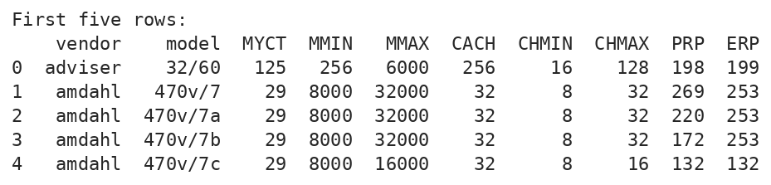
LOADING THE DATA
url = (
"https://archive.ics.uci.edu/ml/"
"machine-learning-databases/cpu-performance/machine.data"
)
columns = [
"vendor", "model", "MYCT", "MMIN", "MMAX",
"CACH", "CHMIN", "CHMAX", "PRP", "ERP"
]
data = pd.read_csv(url, names=columns)
print("First five rows:")
print(data.head())

Slide 23
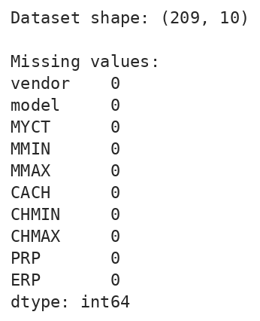
SHAPE AND MISSING VALUES
print("\nDataset shape:", data.shape)
print("\nMissing values:")
print(data.isnull().sum())

Slide 24
DATA VISUALIZATION
data.hist(figsize=(12, 8), bins=15)
plt.tight_layout()
plt.show()

Slide 25
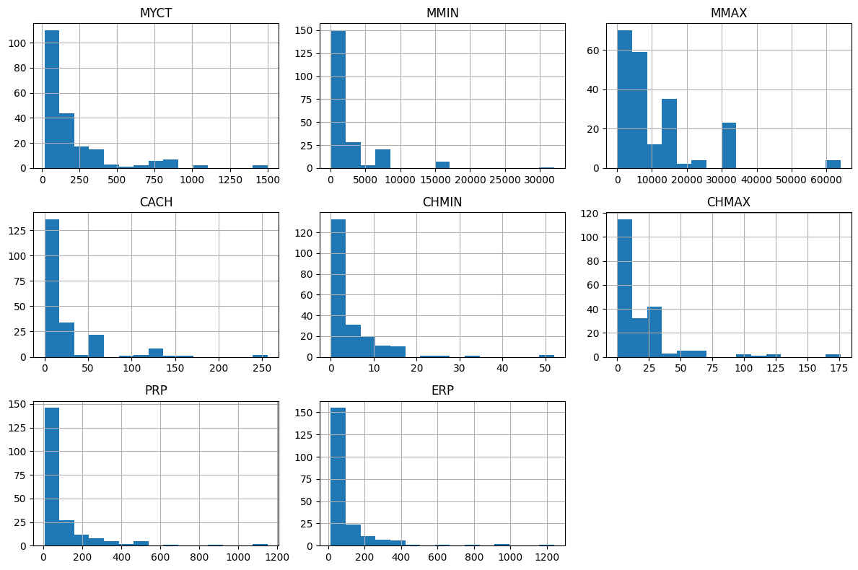
FEATURE HISTOGRAMS

Slide 26
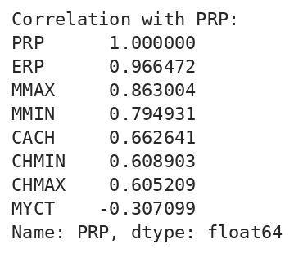
CORRELATION WITH PRP
# Correlation between numerical columns
correlation = data.select_dtypes(include=np.number).corr()
print("\nCorrelation with PRP:")
print(correlation["PRP"].sort_values(ascending=False))

Slide 27
CORRELATION HEATMAP
plt.figure(figsize=(10, 7))
sns.heatmap(correlation, annot=True, cmap="coolwarm", fmt=".2f")
plt.title("Correlation Heatmap")
plt.tight_layout()
plt.show()

Slide 28
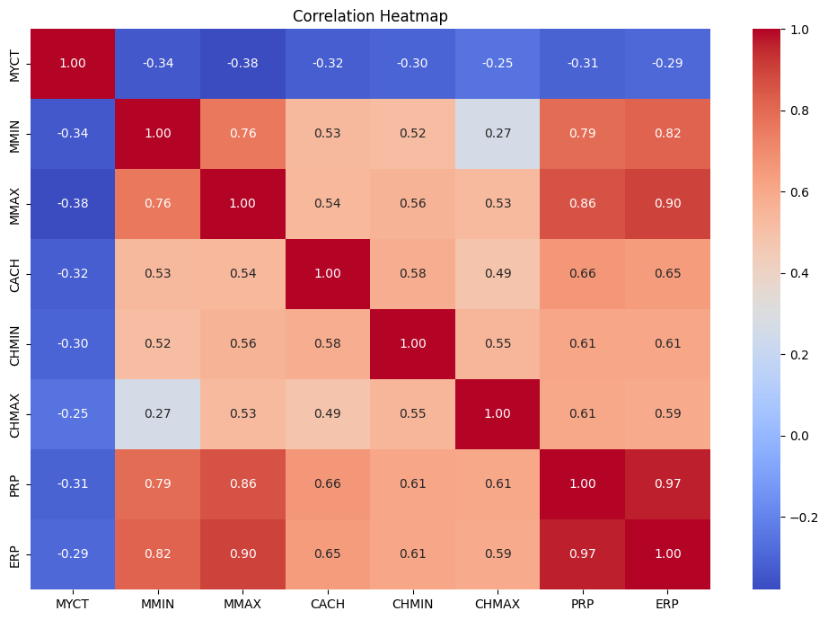
HEATMAP OF CORRELATIONS

Slide 29
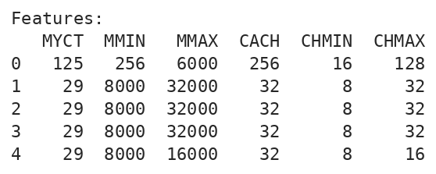
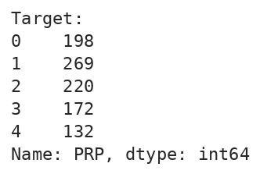
FEATURES AND TARGET
# Predict PRP using hardware characteristics
X = data.drop(columns=["PRP", "ERP", "vendor", "model"])
y = data["PRP"]
print("\nFeatures:")
print(X.head())
print("\nTarget:")
print(y.head())

Slide 30

SPLITTING THE DATA
X_train, X_test, y_train, y_test = train_test_split(
X,
y,
test_size=0.2,
random_state=42
)
print("\nTraining samples:", len(X_train))
print("Testing samples:", len(X_test))

Slide 31
TRAINING RANDOM FOREST
forest_reg = RandomForestRegressor(
n_estimators=200,
random_state=42,
n_jobs=-1
)
forest_reg.fit(X_train, y_train)
y_train_pred = forest_reg.predict(X_train)

Slide 32
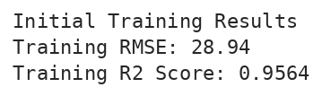
TRAINING RESULTS
train_rmse = np.sqrt(
mean_squared_error(y_train, y_train_pred)
)
train_r2 = r2_score(y_train, y_train_pred)
print("\nInitial Training Results")
print("Training RMSE:", round(train_rmse, 2))
print("Training R2 Score:", round(train_r2, 4))

Slide 33
ACTIVITY 1: PCA
Question 1. Principal Component Analysis (PCA)
Dataset: Fashion MNIST. The dataset contains 28 × 28 grayscale images of clothing items, represented by 784 pixel features per image. Use the Kaggle dataset or competition resources for downloading the data. Dataset link: Fashion MNIST PCA Dataset on Kaggle.
Objective: Apply PCA using three different component-selection approaches and compare their effects on dimensionality reduction and information retention.
Tasks:
Load the dataset into a Pandas DataFrame. Display its shape, first 10 rows, and class distribution.
Separate the image features from the target class labels. Normalize the pixel values and apply StandardScaler before PCA if required by your chosen preprocessing approach. Explain the effect of scaling.

Slide 34
ACTIVITY 1: PCA (CONT.)
Apply PCA using the following three approaches:
Method 1. Fixed number of components: Use PCA(n_components=50) to reduce the 784 pixel features to 50 principal components.
Method 2. Percentage of variance: Use PCA(n_components=0.95) to retain enough components to explain at least 95% of the variance.
Method 3. All components: Use PCA(n_components=None) to retain all available principal components.
For each approach, display the original number of features, the number of retained components, and the cumulative explained variance.
Plot the cumulative explained variance against the number of principal components.
Visualize the dataset in two dimensions using the first two principal components. Color the points according to their clothing classes.
Compare all three approaches in a table. Explain which method provides the greatest dimensionality reduction and which preserves the most information.

Slide 35
ACTIVITY 2: RF CLASSIFIER
Question 2. Random Forest Classification with GridSearchCV
Dataset: Heart Disease UCI. The task is to predict whether a patient has heart disease using patient-related attributes. Dataset link: Heart Disease Dataset on Kaggle.
Tasks:
Load the dataset into a Pandas DataFrame. Display its shape, first 10 rows, missing values, and target class distribution.
Clean the dataset by handling missing values and encoding categorical features where necessary.
Separate the input features X from the target variable y.
Split the data into training and testing sets using an 80/20 ratio, stratify=y, and random_state=42.
Train a basic RandomForestClassifier using default parameters and record its test accuracy.

Slide 36
ACTIVITY 2: GRID SEARCH
Define a parameter grid for GridSearchCV using the values in the table.
Apply GridSearchCV with five-fold cross-validation and scoring='accuracy'. Use random_state=42 for the Random Forest.
Display the best hyperparameters and the best cross-validation accuracy.
Evaluate the best model on the test set using:
Accuracy, Precision, Recall, F1-score
Confusion matrix
Plot the feature importances and identify the three most influential features.
Parameter grid for task 6
Parameter | Values to test
n_estimators | 100, 200
max_depth | None, 10, 20
min_samples_split | 2, 5
min_samples_leaf | 1, 2
max_features | sqrt, log2

Slide 37
ACTIVITY 3: RF REGRESSION
Question 3. Random Forest Regression with GridSearchCV
Dataset: House Prices: Advanced Regression Techniques. This dataset contains housing attributes, and the target variable is SalePrice. The training data contains 1,460 house records and 79 explanatory variables, plus an ID and the target. Dataset link: House Prices Dataset on Kaggle.
Tasks:
Download train.csv from Kaggle and load it into a Pandas DataFrame.
Display the dataset shape, first 10 rows, missing values, and summary statistics of SalePrice.
Separate the input features from the target variable SalePrice. Remove the Id column from the input features because it is an identifier rather than a meaningful house attribute.
Handle missing values and convert categorical variables into numerical features using appropriate preprocessing.
Split the dataset into training and testing sets using an 80/20 ratio and random_state=42.
Train a basic RandomForestRegressor using default parameters and record its performance.

Slide 38
ACTIVITY 3: GRID SEARCH
Define the parameter grid shown in the table.
Use GridSearchCV with five-fold cross-validation and scoring='neg_mean_squared_error'. Set random_state=42 for the Random Forest.
Display the best hyperparameters and the best cross-validation score. Convert the negative mean squared error into a positive MSE and take its square root to obtain RMSE.
Evaluate the best model on the test set using MAE, MSE, RMSE and the R² score.
Compare the default and optimized models in a table.
Plot the actual versus predicted house prices and display the feature importances of the five most influential features.
Parameter grid for task 7
Parameter | Values to test
n_estimators | 100, 200
max_depth | None, 10, 20
min_samples_split | 2, 5
min_samples_leaf | 1, 2
max_features | 0.7, 1.0

